Slide 1
Course Name: Fundamentals of Investment
Week 3: Approaches to Equity Analysis

Slide 2
Week 3: Learning Objectives
The basic objective is to understand the basic approaches to Equity Analysis. The aim is to share in detail the Fundamental Analysis, Technical Analysis and Efficient Market Hypothesis so that learners will be able to analyse and predict equity value.

Slide 3

Fundamental Analysis
BBA-V Securities Analysis and Portfolio Management

Slide 4
Objectives of Fundamental Analysis
After studying this lesson, you should be able to:
Make Analysis of Economy
Current State of Economy and Indicators
Tools for Economic Analysis
Economic Forecasting
BBA-V Securities Analysis and Portfolio Management

Slide 5
Introduction to Equity Analysis
Investment decisions are a part of our economic life.
Everybody makes such decisions in different contexts at different times. Some are able to reap more profits through them while others simply lose their money.
Attempts should, therefore, be made to understand and know the way sound investments decision can be made in order to make more profits through them.
The investment decision maker takes them into account in order to decide which securities should be bought or held or sold by him.
Example Reliance Industry (Rs.2957), MRF (Rs. 144199)
Example Suzlon Energy (Rs. 40.55)
BBA-V Securities Analysis and Portfolio Management

Slide 6
FUNDAMENTAL ANALYSIS
Can be Classified in Three Parts-
  Economic Analysis
  Industry Analysis
  Company Analysis
BBA-V Securities Analysis and Portfolio Management

Slide 7
The price prevailing in market is called "market price' (MP)
the one justified by its fundamentals is called 'intrinsic value' (IV).
If IV > MP, buy the security
If IV < MP, sell the security
If IV = MP, no action
BBA-V Securities Analysis and Portfolio Management

Slide 8
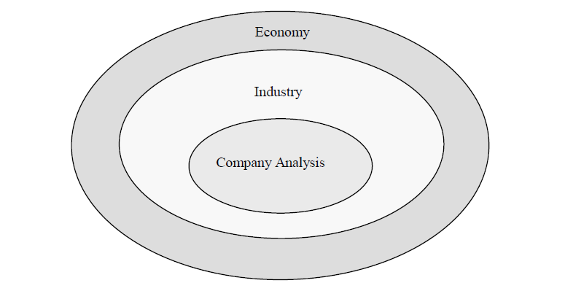
Economy Analysis
BBA-V Securities Analysis and Portfolio Management

Slide 9
Economic Forces
Population
Performance of Agriculture
Technological Development
Natural Resources
Role of Government
Business Conditions
Political Stability
Balance of Trade

Slide 10
Macro Economic Analysis
The analysis of the following factors indicate the trends in macro economic changes that effect the risk and return on investments.
Money supply
Industrial production
Capacity utilization
Unemployment
Inflation
Growth in GDP
Institutional lending
Stock prices
Monsoons
BBA-V Securities Analysis and Portfolio Management

Slide 11
Fiscal Policy
Fiscal policy is concerned with the spending and tax initiatives of the government. It is the most direct tool to stimulate or dampen the economy.
An increase in government spending stimulates the demand for goods and services, whereas a decrease deflates the demand for goods and services.
A decrease in tax rates increases the consumption of goods and services and an increase in tax rates decreases the consumption of goods and services.
BBA-V Securities Analysis and Portfolio Management

Slide 12
Monetary Policy
Monetary policy is concerned with the manipulation of money supply in the economy. Monetary policy affects the economy mainly through its impact on interest rates.
The main tools of monetary policy are:
  Open market operation
  Bank rate
  Reserve requirements
  Direct credit controls
BBA-V Securities Analysis and Portfolio Management

Slide 13
Open Market Operations
  refer to the selling and purchasing of the treasury bills and government securities by the central bank of any country in order to regulate money supply in the economy.
Central bank sells securities in the market when it wants to reduce the money supply in the market It is done to increase interest rates.
When the central bank wants to increase the money supply in the market it will purchase securities from the market this step is taken to reduce the rate of interest and also to help the economic growth of the country
It impacts both the supply and demand for credit.
BBA-V Securities Analysis and Portfolio Management

Slide 14
Bank rate
A bank rate is the interest rate at which a nations central bank lends money to domestic banks and it’s a very short term loan.
Lower bank rate result lowering the cost of funds for borrowers
Higher bank rate results higher the cost of funds for borrowers
BBA-V Securities Analysis and Portfolio Management

Slide 15
Reserve Requirements
The amount of funds that a bank holds in reserve to ensure that it is able to meet liabilities in case of sudden withdrawals
Reserve requirements are a tool used by the central bank to increase or decrease the money supply in the economy and influence interest rates.
BBA-V Securities Analysis and Portfolio Management

Slide 16
Direct Credit Control
The central bank can direct deposit money banks on the maximum percentage or amount of loans to different economic sectors or activities interest rate caps, Liquid asset ratio and issue credit guarantee to preferred loans.
BBA-V Securities Analysis and Portfolio Management

Slide 17
Economic Forecasting
Techniques used
Economic indicators
Surveys
BBA-V Securities Analysis and Portfolio Management

Slide 18
Anticipatory Surveys
This is very simple method through which investors can form their opinion/expectations with respect to the future state of the economy.
This is a survey of expert opinions of those prominent in the government, business, trade and industry.
Anticipatory surveys can also incorporate the opinion or future plans of consumers regarding their spending.
Surveys should provide valuable input, as a starting point.
BBA-V Securities Analysis and Portfolio Management

Slide 19
Leading Indicators
Average weekly hours of manufacturing production workers
Average weekly in initial unemployment claims
Contacts and orders for plant and machinery
Index of S&P 500 stock prices
Money supply (M2)
Change in sensitive material prices
Change in manufacture's unfilled orders (durable goods industries)
Index of consumer expectations.
BBA-V Securities Analysis and Portfolio Management

Slide 20
Lagging Indicators
Average duration of unemployment
Ratio of manufacturing and trade inventories to sales
Average prime rate
Outstanding commercial and industrial loans
BBA-V Securities Analysis and Portfolio Management

Slide 21
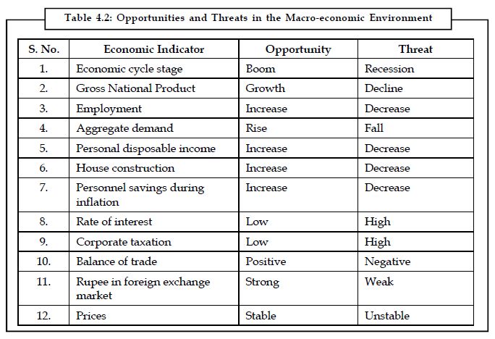
Economy and Industry Analysis
BBA-V Securities Analysis and Portfolio Management

Slide 22
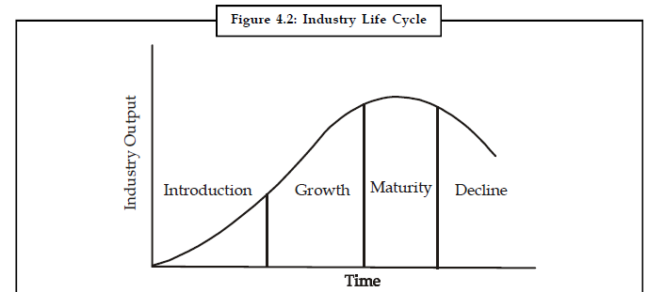
Industry Analysis
After conducting an analysis of the economy and identifying the direction it is likely to take in the short, interim and long-term, the analyst must look into various sectors of the economy in terms of various industries. An industry is a homogenous group of companies
BBA-V Securities Analysis and Portfolio Management

Slide 23
Key Indicators in Analysis
Performance Factors like:
(a) Past sales
(b) Past earnings
2. Environment Factors like:
(a) Attitude of government
(b) Labour conditions
(c) Competitive conditions
(d) Technological progress
BBA-V Securities Analysis and Portfolio Management

Slide 24
Key Indicators in Analysis
Outcome Factors like:
(a) Industry share prices
(b) Price earnings multiples with reference to these key factors, evaluations shall be done to identify.
(c) Strengths and weaknesses
(d) Opportunities and threats
BBA-V Securities Analysis and Portfolio Management

Slide 25
Forecasting Methods
The Market Profile
Cumulative Methods
  Surveys
  Correlation and Regression analysis
  Time series analysis
BBA-V Securities Analysis and Portfolio Management

Slide 26
The Market Profile
Number of establishments
Geographical location of establishment
Number of employees
Value of sales
Value added by manufacturing
Capital expenditures
Degree to which establishments are specialized
Importance of their output in the national total
BBA-V Securities Analysis and Portfolio Management

Slide 27
Cumulative Methods
Surveys: Surveys are carried out by research agencies, consultants, industry association and the research bureau of media. These surveys generally study the current facilities and demand, future demand and proposed investment, and thereby the expansion prospects vis-à-vis demand gap. Other factors like, strengths and weaknesses of the organization, environmental forces are also brought into focus to evaluate the future of the industry.
BBA-V Securities Analysis and Portfolio Management

Slide 28

Correlation and Regression analysis
Statistical methods like correlation and regression analysis can be of much help in demand measurement. The following steps have general application.
Determine the total requirement for the type of product in question by present customers in each industry classification.
The correlation can be observed by preparing a scatter diagram, as shown in figure or calculating mathematically, using the formula given below:
BBA-V Securities Analysis and Portfolio Management

Slide 29

Demand Estimation
Apply the relationship to estimate demand. If the degree of correlation between purchases of a given product by present customers and their employment size is considered significant, the demand estimation can be done as follows:
BBA-V Securities Analysis and Portfolio Management

Slide 30
Industry Analysis Factors
Post-sales and earnings performance
The government's attitude towards industry
Labour conditions
Competitive conditions
Performance of the industry
Industry share prices relative to industry earnings
Stage of the industry life cycle
Industry trade cycle
Inventories build-up in the industry
Investors' preference over the industry
Technological innovations
BBA-V Securities Analysis and Portfolio Management

Slide 31
Company Analysis
In order to provide a proper perspective to this analysis, let us begin by discussing the way investor makes investment decisions given his goal maximization. For earning profits, investors apply a simple and common sense decision rule of maximization. That is:
Buy the share at a low price
Sell the share at a high price
Que 1 how to find out whether the price of a company’s share is high or low?
Que 2 What is the benchmark used to compare the price of the share?
BBA-V Securities Analysis and Portfolio Management

Slide 32
Framework of Company Analysis
The two major components of company analysis are:
Financial
Non-financial
BBA-V Securities Analysis and Portfolio Management

Slide 33
Non-financial component
The analyst will be concerned with two broad categories information:
  internal and
  external.
Internal information consists the data and events relating to the enterprise as publicized by it.
External information comprises the reports and analyses made by sources outside the company viz. media and research agencies.
BBA-V Securities Analysis and Portfolio Management

Slide 34
Non-financial Aspects
History and business of the company
Top management team
Collaboration agreements
Product range
Future plans of expansion/diversification
R&D
Market standing – competition and market share
Corporate social responsibility
Industrial relations scenario
Corporate image etc.
BBA-V Securities Analysis and Portfolio Management

Slide 35
External Environment
Statutory controls
Government policy
Industry life cycle stage
Business cycle stage
BBA-V Securities Analysis and Portfolio Management

Slide 36
Methods of Company Analysis
Trend analysis
Ratio analysis
Fund flow analysis
Common size statement analysis
Technical analysis
BBA-V Securities Analysis and Portfolio Management

Slide 37
TREND ANALYSIS
It is a dynamic method of analysis showing the changes over a period of time. It makes easy to understand the changes in an item over a period of time and to draw conclusion regarding the changes in data. The trend should be studied at least over a period of 5 years. It indicates a direction in which a concern is going and on this basis forecast for future can be made.
BBA-V Securities Analysis and Portfolio Management

Slide 38
RATIO ANALYSIS
Current ratio: Current ratio is also known as solvency ratio or working capital ratio. Standard current ratio is 2:1
current ratio indicates the short-term financial position of the
firm. It is expressed as pure ratio.
It is calculated as:
Current ratio = Current assets /Current liabilities
BBA-V Securities Analysis and Portfolio Management

Slide 39
Current assets consists of all the current assets of the concern such as:
Debtors
Cash and bank balance
Bills receivable
Stock
Prepaid expenses
BBA-V Securities Analysis and Portfolio Management

Slide 40
Current liabilities consist of the following:
Creditors
Bills payable
Outstanding expenses
Bank overdraft
BBA-V Securities Analysis and Portfolio Management

Slide 41
Quick Ratio
Quick ratio: Quick ratio is also known as liquidity ratio or acid ratio. Standard quick ratio is 1:1 greater the ratio, stronger the financial position. It indicates the solvency and financial soundness of the business. It is expressed as pure ratio.
It is calculated as:
Quick Ratio = Current asset (less stock and prepaid Expenses)/Current Liabilities
BBA-V Securities Analysis and Portfolio Management

Slide 42
Debt Assets Ratio
This ratio indicates the percentage or the proportion of the total assets created by the company through short-term and long-term debt.
It can be calculated as:
Debt assets ratio = Debt/Equity
where, Debt = all liabilities including the short-term or long-term,
Assets = all assets, i.e., fixed and current.(Excluding Fictitious Assets)
BBA-V Securities Analysis and Portfolio Management

Slide 43
Debt Equity Ratio
It shows the proportion of debt to assets. It is expressed pure ratio.
It can be calculated as:
Debt equity ratio = Debt / Equity
where, Debt = all liabilities including long-term and short-term
Equity = net worth(Equity Share and All Reserve and Surplus) + preference capital.
BBA-V Securities Analysis and Portfolio Management

Slide 44

Stock To Working Capital Ratio
Stock to working capital ratio express the relationship
between closing stock and working capital. This ratio expressed as pure ratio or percentage Ratio.
It can be calculated as:
BBA-V Securities Analysis and Portfolio Management

Slide 45
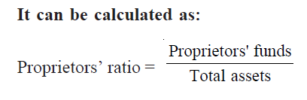
Proprietors Ratio
This ratio indicates the proportion of proprietors’ funds to the total assets of the firm.
BBA-V Securities Analysis and Portfolio Management

Slide 46
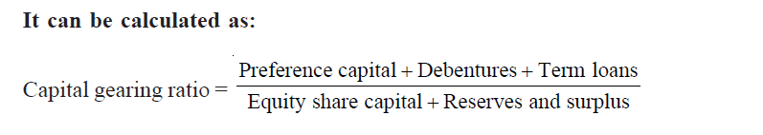
Capital Gearing Ratio
This ratio includes the relation between fixed income bearing
securities to funds on which no fixed returns are to be paid. It is expressed as pure ratio.
BBA-V Securities Analysis and Portfolio Management

Slide 47

Introduction of Technical Analysis
Technical analysis is a study of market data in terms of factors affecting supply and demand schedules, such as prices, volume of trading.
It is a simple and quick method of forecasting behaviour of share prices.
The financial data and past behaviour of share price of a company are presented on charts and graphs in order to find out the history of price movements.

Slide 48
Introduction of Technical Analysis
It helps to explain and forecast changes in share prices.
Technical analysis provides a simplified picture of price Behaviour of a share.
The analysis believe that the price of the share depends upon the supply and demand in the stock market.
They get the important information about price and volume of a share in the stock market.

Slide 49
Assumptions of Technical Analysis
The price of security is related to demand and supply factors operating in the market.
There are rational as well as irrational factors which affects the supply and demand factors of a security.
The prices of securities behave in a manner that their movement is continuous in a particular direction for some length of time.
Trends in the price of securities have been seen to change when there is a shift in the demand and supply factors.
Whenever there are shifts in demand and supply, they can be detected through charts prepared specially to show the action of the market.

Slide 50
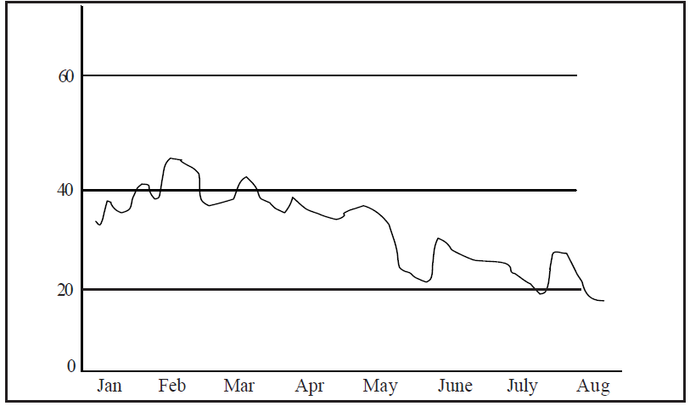
Line Chart

Slide 51
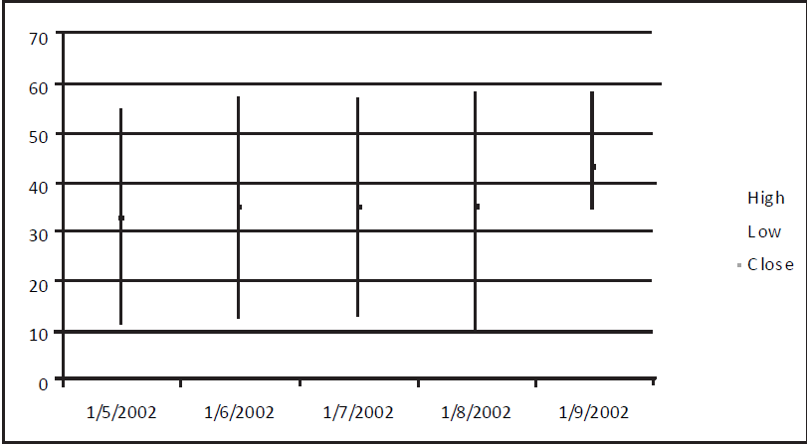
Bar Chart

Slide 52
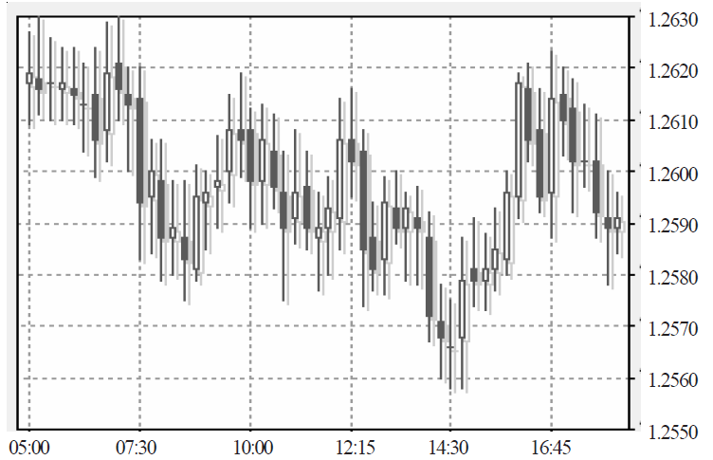
Candlestick chart

Slide 53
CHART PATTERNS
Support and resistance levels
Head and shoulders configuration
Trend Analysis

Slide 54
Support and resistance levels
A support level is a barrier or price decline while a resistance level is a barrier to price advancement.
Stock prices may break support and resistance levels under abnormal circumstances.
the stock of ‘A’ Ltd. is currently trading at ` 35. in the recent past, it has been as low as ` 30 and as high as ` 45. when this stock trades at ` 30 or 50, it becomes an attractive investment because the stock has support level of ` 30 with a potential resistance level at 45. The investor may start buying this stock at ` 30 and the stock begins to advance in price.

Slide 55
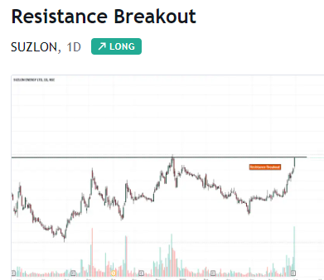

Slide 56
Head and shoulders configuration
Head and shoulders is the key reversal pattern.
The basic reversal patterns help analysis identify the turning points so that they can decide when to buy and sell the stock.
The configuration is an uptrend or downtrend in a stock.

Slide 57
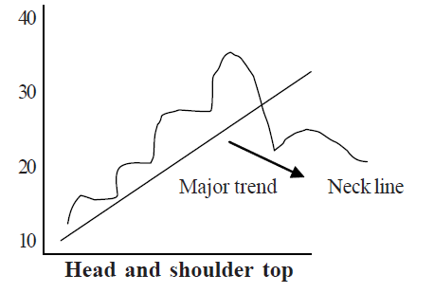

Slide 58
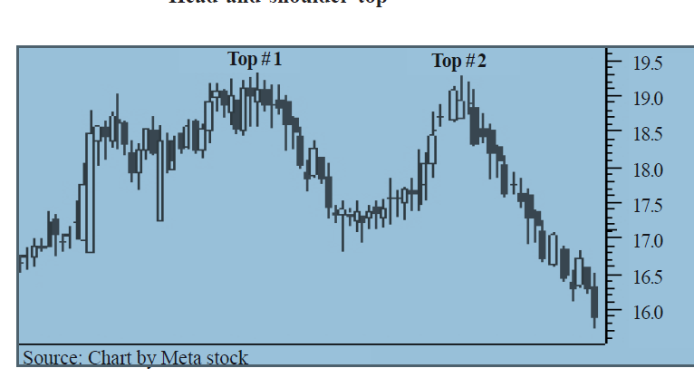

Slide 59
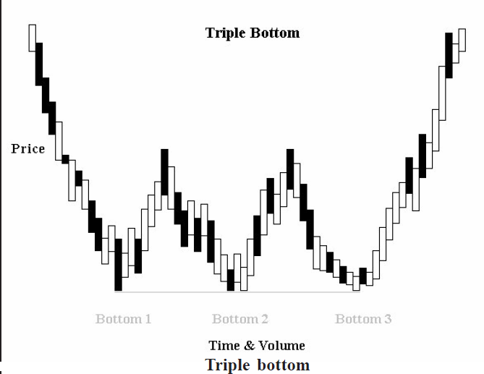

Slide 60
Trend Analysis
The technical analysts can establish a major trend in the prices of stocks.
There may be a major uptrend or downtrend. There may be a reversal of major uptrend at a particular point. A major trend is preceded by notable advancement in stock’s price.

Slide 61
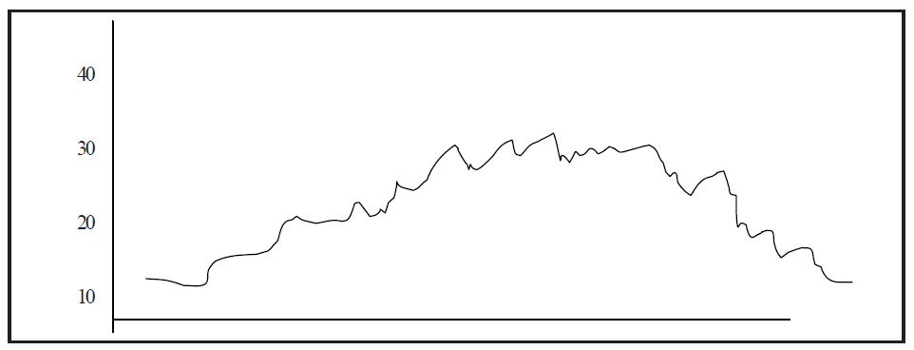

Slide 62
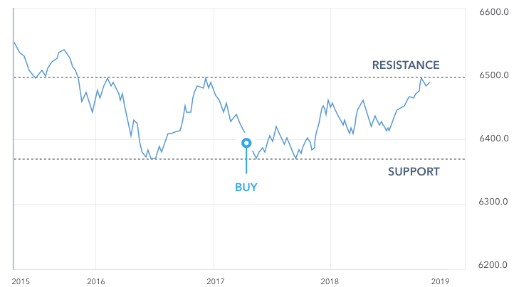
What is support and resistance

Slide 63
How to identify support and resistance level
Historical price data
Previous support and resistance levels
Technical indicators

Slide 64
How to draw support and resistance lines
To draw support and resistance lines on a chart, you first have to find them by using one of the following methods:
Peaks and troughs
Support and resistance levels from a previous timeframe
Moving averages
Trend lines

Slide 65
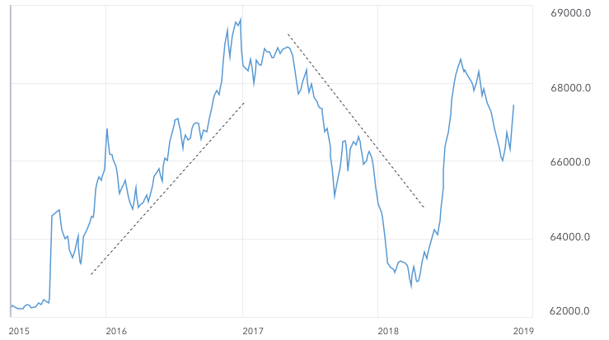
Peaks and troughs

Slide 66
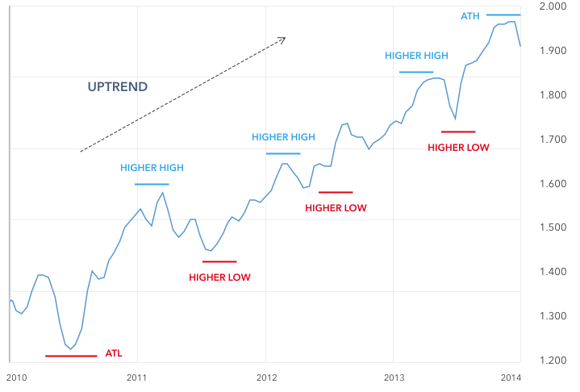

Slide 67
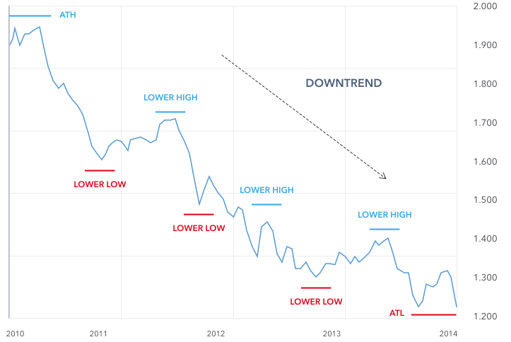

Slide 68
Previous timeframes
If you’re using support and resistance levels from a previous timeframe, choose a short timeframe, for example 15 minutes. Then, draw the levels from the one-hour and four-hour time frames on the 15-minute frame.

Slide 69
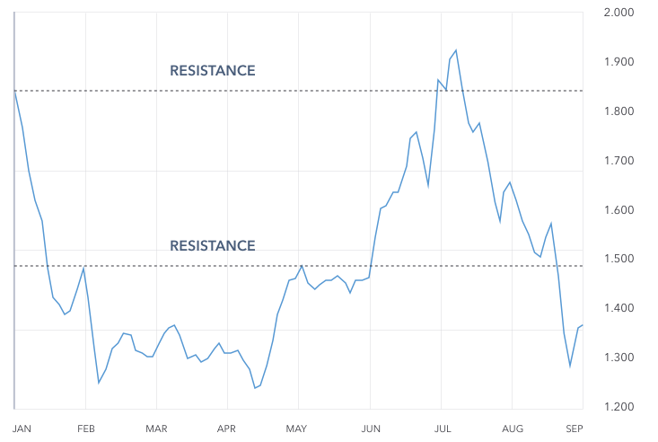

Slide 70
Moving averages
The moving average indicator is another way to identify support and resistance levels, and draw them on a chart. With the indicator enabled, draw a diagonal line from the highest peak to the lowest peak to see which way the trend is moving.

Slide 71
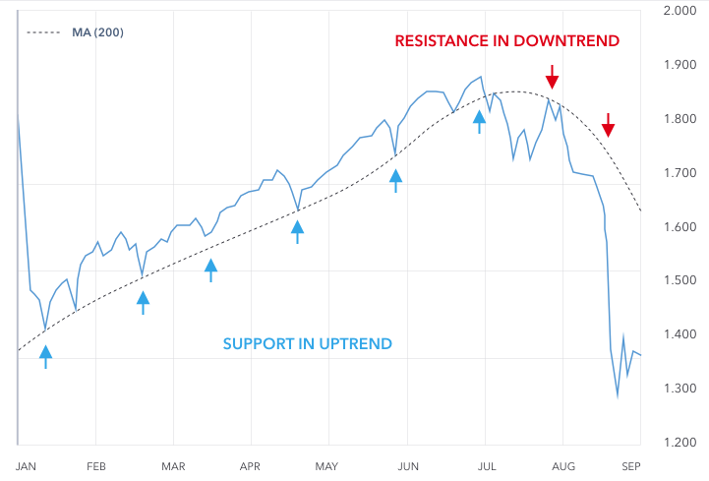

Slide 72
Trend lines
If you are using trend lines, make sure you have at least three peaks or three troughs before you draw your lines, so that you have a useable trend line. Then, once you've plotted the trend lines onto your chart, your uptrend line will be the support level, while the down trend line will be the resistance level.

Slide 73
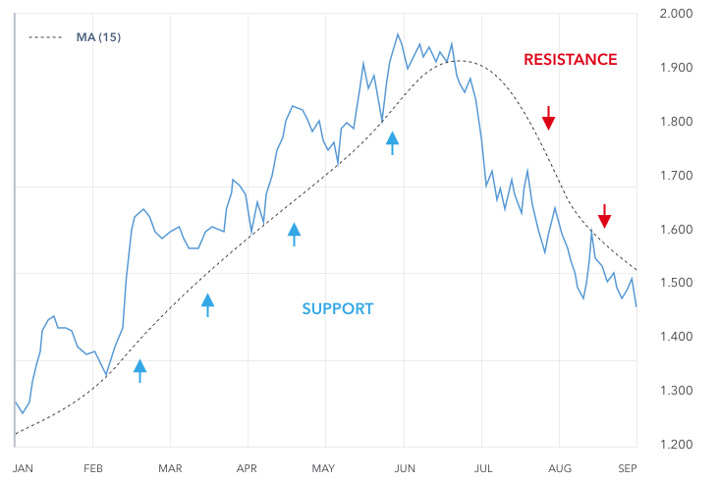

Slide 74
Dow Theory
The Dow Theory is an approach to trading developed by Charles H. Dow, who, with Edward Jones and Charles Bergstresser, founded Dow Jones & Company, Inc. and developed the Dow Jones Industrial Average in 1896.

Slide 75
How the Dow Theory Works
The Market Discounts Everything
There Are Three Primary Kinds of Market Trends(next slide)

Slide 76
A bull market's phases are
Accumulation phase: Prices rise alongside an increase in volume.
Public participation (or big move) phase: Retail and average investors begin to notice the upward trend and join in—generally, this is the longest phase.
Excess phase: The market reaches a point where experienced investors and traders begin exiting their positions while the larger average investing population continues to add to their positions.

Slide 77
A bear market's phases are the:
Distribution phase, where news of a decline begins to be distributed throughout the investing community via various channels.
Public participation phase: Opposes that of a bull market participation phase—average and retail investors are selling stocks and exiting positions to reduce losses. Again, this is generally the longest phase.
Panic (or despair) phase: Investors have lost all hopes of a correction or full reversal and continue selling at scale.

Slide 78
Volume Must Confirm the Trend
Trading volume generally increases if the price moves in the direction of the primary trend and decreases if it moves against it. Low volume signals a weakness in the trend. For example, in a bull market, buying volume should increase as the price rises and falls during secondary pullbacks because traders still believe in the primary bullish trend. If selling volume picks up during a pullback, it could be a sign that more market participants are turning bearish.

Slide 79

Meaning of market Efficiency
Market efficiency describes the extent to which available information is quickly reflected in the market price. In other words, an efficient market is one in which the price of every stock or security incorporates all the available information, and hence the price is the “true” investment value.
MBA-III Securities Analysis and Portfolio Management
BBA-VI Fundamentals of Investment

Slide 80
Market Value and Intrinsic Value
The market value of an asset is the price at which an asset can currently be bought or sold.
The intrinsic value is the value that would be placed on it by investors if they had a complete understanding of the asset’s investment characteristics.
MBA-III Securities Analysis and Portfolio Management
BBA-VI Fundamentals of Investment

Slide 81
Factors that Affect a Market’s Efficiency
Market Participants: In general, as the number and sophistication of participants within a market increase, the market becomes more efficient.
Information Availability and Financial Disclosure: The more information market participants have, the more accurate the market’s estimates of intrinsic value, thus creating greater market efficiency. In highly efficient markets, information is provided to all market participants at the same time, and the advantage of insider trading is limited.
Limits to Trading: Regulatory limits on activities such as short selling influence the actions of investors who may want to explore market inefficiencies and take advantage to make risk-free profits. The more stringent the restrictions, the more likely the market will be inefficient.
Transaction and Other Costs: The efficiency of a market is defined by the ease and availability of information regarding security prices. If the cost of obtaining and analyzing extra information results in more profits, then investors may look to explore more of active management, thus affecting the overall efficiency of the market.
MBA-III Securities Analysis and Portfolio Management
BBA-VI Fundamentals of Investment

Slide 82
Forms of Efficient Market Hypothesis
Weak Form
All historical prices of securities have already been reflected in the market prices of securities.
Investors trading based on information from technical analysis (analysis of historical stock returns) should not earn abnormal returns.
According to research, at least weak form of efficiency is attained in developed markets.
Emerging/less developed markets may offer the opportunity to profit from technical analysis. Hence, these markets are not even weak-form efficient (known as inefficient).
MBA-III Securities Analysis and Portfolio Management
BBA-VI Fundamentals of Investment

Slide 83
Semi-Strong Form
Market prices reflect all the publicly available information including all historical price information.
Fundamental analysis does not result in higher earnings/returns to the investor.
Costs of obtaining additional information override the returns that the additional information might generate.
Market surprises do not lead to abnormal returns as markets are quick to adjust and resume normalcy.
MBA-III Securities Analysis and Portfolio Management
BBA-VI Fundamentals of Investment

Slide 84
Strong Form
Market prices reflect both private and public information.
Insider information does not lead to higher returns.
Most regulations would impose trade restrictions on senior company managers who have access to price-sensitive company information.
Research shows that markets are not generally strong form efficient as abnormal returns can be earned when private information is used.
MBA-III Securities Analysis and Portfolio Management
BBA-VI Fundamentals of Investment

Slide 85
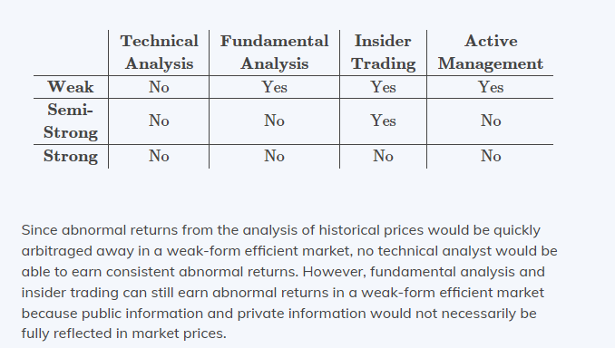
Fundamental Analysis, Technical Analysis, and the Choice Between Active and Passive Portfolio Management
MBA-III Securities Analysis and Portfolio Management
BBA-VI Fundamentals of Investment

Slide 86
Difficulty with testing the Efficient Market Hypothesis
Testing the Strong Form of EMH: This is difficult because it requires the investor or the researcher to have access to information that is not in the public domain in the first place. Studies also show that, even though directors have reach of this information, it is still not possible to outperform the market. This can be explained by the fact that certain regulations impose restrictions on senior management of any company on misusing their powers by for example, banning them from trading.
MBA-III Securities Analysis and Portfolio Management
BBA-VI Fundamentals of Investment

Slide 87
Testing the Weak Form of EMH: If an investor uses historical prices to try and anticipate future prices (also called technical or chartist analysis), he/she will fail to identify the difference between the returns on securities and those from purely random stock selection after allowing for transaction costs, as studies have shown.
MBA-III Securities Analysis and Portfolio Management
BBA-VI Fundamentals of Investment

Slide 88
Testing the Semi-Strong Form of EMH: The EMH is based on the principle that security prices reflect the information available. It does not however explain how the information affects the prices. Studies have shown that markets over\under react to events and/or new information, and take quite some time before reverting to normalcy. If this happens, the investors may take this opportunity to take advantage of the time before “healing” to make higher returns, and thus EMH would not hold. This is often called informational efficiency
MBA-III Securities Analysis and Portfolio Management
BBA-VI Fundamentals of Investment

Slide 89
Behavioral Finance
Behavioral finance examines investor behavior to understand how people make decisions, individually and collectively. It relates to the psychology that drives individuals’ choices when making investment decisions.
MBA-III Securities Analysis and Portfolio Management
BBA-VI Fundamentals of Investment

Slide 90
Common Findings of Behavioral Finance
Behavioral finance does not assume that investors always act rationally, but instead that people can be negatively affected by behavioral biases.
Market efficiency does not require all market participants to act rationally as long as the market acts rationally in aggregate. If the market can quickly adjust for irrationality, then behavioral finance does not necessarily contradict market efficiency. However, if the market allows its participants to earn abnormal returns from the irrationality of others, then the market cannot be efficient.
MBA-III Securities Analysis and Portfolio Management
BBA-VI Fundamentals of Investment

Slide 91
Dividend Discount Model – According to this model the value of an equity share is equal to the present value of dividends expected from its ownership plus the present value of the sale price expected when the equity share is sold. For applying the dividend discount model we will make the following assumptions-
Dividends are paid annually
The first dividend is received one year after the equity share is bought
Ve = (D1 / Ke – G) *100
D1= dividend amount per share to be paid in next year
Ke= investors expected rate of return
G= constant rate of growth in dividend
BBA VI Fundamentals of Investment
BBA V SEMESTER SAPM

Slide 92
Dividend on a equity share expected to be paid next year is Rs. 3.5 per share these have a face value of Rs. 10 each. Dividends are expected to grow at a constant growth rate of 6 % infinitely. An investor expects a return of 17% per annum suggest him at what price he should buy these shares.
Ve = (D1 / Ke – G) *100
D1= dividend amount per share to be paid in next year = 3.5
Ke= investors expected rate of return = 17%
G= constant rate of growth in dividend = 6%
Ve = (3.5 / 17-6) *100 = 31.82 Rs.
Value of equity shares for this investor is Rs. 31.82 Per Share.
BBA VI Fundamentals of Investment
BBA V SEMESTER SAPM

Slide 93
Ex. Dividend on a equity share during the current year is Rs. 6.5 per share, these have a face value of Rs. 10 each. Dividends are expected to grow at a constant growth rate of 8% per annum infinitely. An investor expects a return of 20% per annum; suggest him at what price should he buy these shares.
Ve = (D1 / Ke – G) *100
D1= dividend amount per share to be paid in next year = (6.5*1.08 = 7.02)
Ke= investors expected rate of return = 20%
G= constant rate of growth in dividend = 8%
Ve = (7.02 / 20-8) *100 = 58.50 Rs.
Value of equity shares for this investor is Rs. 58.50 Per Share.
BBA VI Fundamentals of Investment
BBA V SEMESTER SAPM

Slide 94
Currently dividend per share is Rs. 5, growth expected during the next five year is 10% p.a. thereafter, the dividends are likely at a constant rate of 7% p.a. if an investor expects a return of 16% p.a. find out what is the value of these shares for this investor.
Year | Dividends | Pvif at 16% | Present Value
1 | 5.5 (5% +10%) | .862 | 04.74
2 | 6.05 | .743 | 4.5
3 | 6.66 | .641 | 04.26
4 | 7.32 | .552 | 04.04
5 | 8.06 | .476 | 03.84
Total P.V. of Div |  |  | 21.38 Rs.
BBA VI Fundamentals of Investment
BBA V SEMESTER SAPM

Slide 95
P5 = (D1 / Ke – G) *100
D1= dividend amount per share to be paid in next year = 8.62
Ke= investors expected rate of return = 16%
G= constant rate of growth in dividend = 7%
P5 = (8.87 / 16-7) *100 = 95.78 Rs.
Present value of P5 = 95.78 *.476 = 45.59
Value of equity shares for this investor is Rs. 45.59 + 21.38 =69.97 Rs. Per Share.
BBA VI Fundamentals of Investment
BBA V SEMESTER SAPM

Slide 96
Replacement Cost – Another balance sheet measure considered by analysis in valuing a firm is the replacement cost of its assets less liabilities.
BBA VI Fundamentals of Investment
BBA V SEMESTER SAPM

Slide 97
Price to Earnings Ratio or Price to Earnings Multiple is the ratio of share price of a stock to its earnings per share (EPS). PE ratio is one of the most popular valuation metric of stocks. It provides indication whether a stock at its current market price is expensive or cheap. Let us explore what is PE ratio, its different types and how to use them in investment decisions.
P/E Ratio=Earnings per share / Market value per share​
BBA VI Fundamentals of Investment
BBA V SEMESTER SAPM

Slide 98
As a historical example, let's calculate the P/E ratio for Walmart Inc. (WMT) as of Feb. 3, 2021, when the company's stock price closed at $139.55.2 The company's earnings per share for the fiscal year ending Jan. 31, 2021, was $4.75, according to The Wall Street Journal.3
Therefore, Walmart's P/E ratio was:
$139.55 / $4.75 = 29.38
BBA VI Fundamentals of Investment
BBA V SEMESTER SAPM

Slide 99
Price to Book ratio - Many investors use the price-to-book ratio (P/B ratio) to compare a firm's market capitalization to its book value and locate undervalued companies. This ratio is calculated by dividing the company's current stock price per share by its book value per share (BVPS).
P/B ratios under 1.0 are typically considered solid investments by value investors.
P/B Ratio=Book Value per Share / Market Price per Share​
Assume that a company has $100 million in assets on the balance sheet, no intangibles, and $75 million in liabilities. Therefore, the book value of that company would be calculated as $25 million ($100M - $75M).
If there are 10 million shares outstanding, each share would represent $2.50 of book value. Therefore, if the share price is $5, the P/B ratio would be 2.0 (5 / 2.50).
BBA VI Fundamentals of Investment
BBA V SEMESTER SAPM

Slide 100
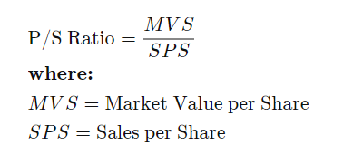
Price Sales Ratio - The price-to-sales ratio (Price/Sales or P/S) is calculated by taking a company's market capitalization (the number of outstanding shares multiplied by the share price) and divide it by the company's total sales or revenue over the past 12 months.
BBA VI Fundamentals of Investment
BBA V SEMESTER SAPM

Slide 101
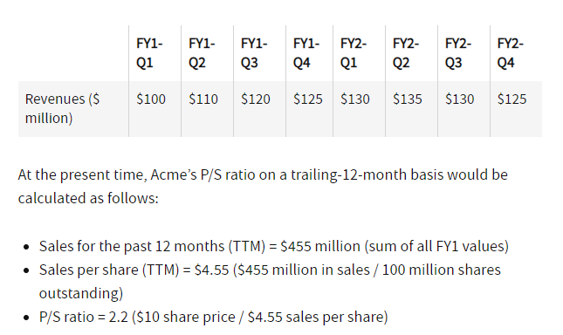
BBA VI Fundamentals of Investment
BBA V SEMESTER SAPM

Slide 102
Learning Outcome
Learners will have basic knowledge about Fundamental analysis and its various components.
Learners will be able to construct various charts and explain price movements.
Learners will be able to explain random walk theory and efficent market hypothesis.

